Slide 1








Stock Price Trend Prediction
Based on Dimension Reduction Techniques and
Cluster Analysis of Multi-Dimensional Financial Data
何其佳 梁瑞玮 冯钰茹 祝欣奕

Slide 2

Background & Goals
CATALOGUE
Basic Information
· Data scraping
· Data description
Analysis
· EDA
· Factor Analysis
· K means clustering
· Mutiple linear regression
· Potential stock prediction
· Outliers exploration

Slide 3
Background & Goals
Background
In the modern economy, investors are faced with a large number of investment choices. How to select high-quality investment targets from numerous companies is a complex and challenging task.
Goals
Use factor analysis and clustering methods to achieve company rating classification
Provide investment advice to investors through company financial statement data

Slide 4
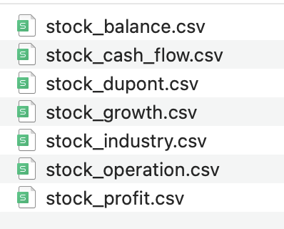
Basic information
Data scraping
From www.baostock.com
The operations of 5156 listed companies in China in the fourth quarter of 2023 were obtained. There are 6 sets of data, about 40 to 50 columns.

Slide 5
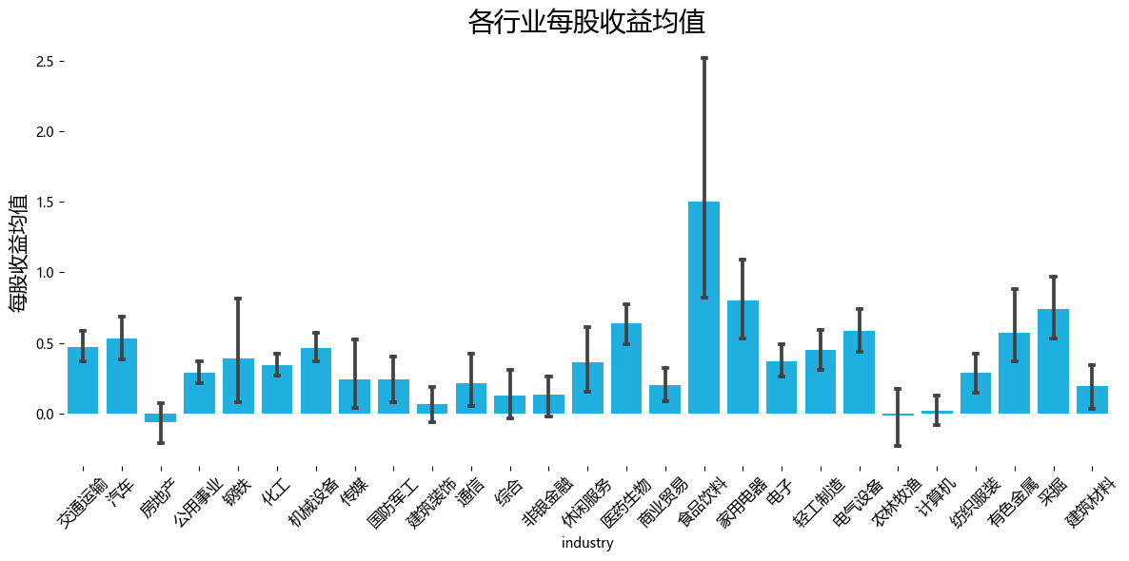
Data description
Biased: For different industries, the prices and returns of stocks show obvious fluctuation trends.

Slide 6
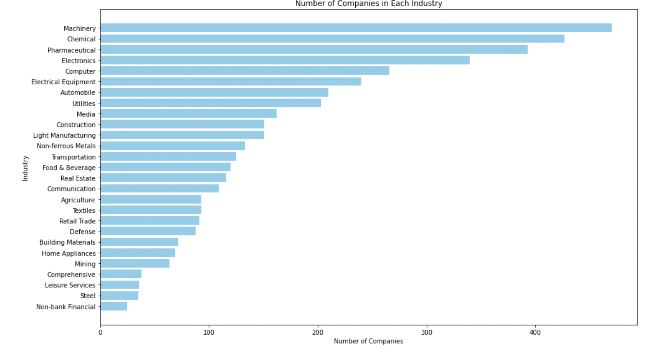
Data description
Industries selection
Among all industries, we chose the three industries with the largest number of listed companies as examples : machinery, chemicals, pharmaceuticals

Slide 7
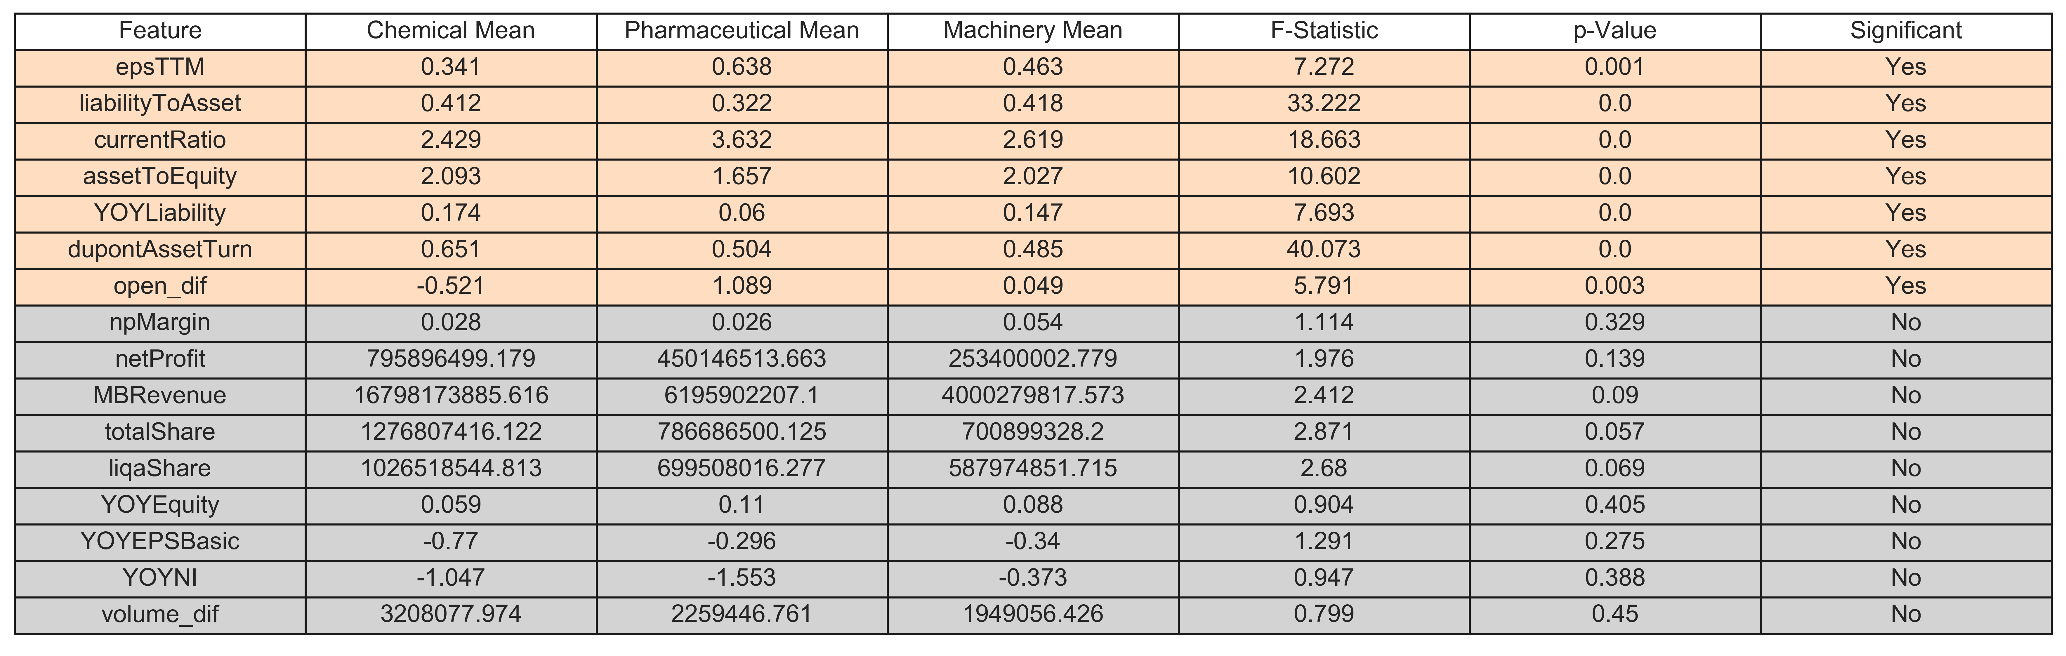
Data description
Results: There are a large number of financial indicators that differ significantly across industries. Therefore, we need to analyze and predict separately according to the industry.

Slide 8
Data description
Features selection
In order to avoid data redundancy and duplication, 14 columns of data were manually screened from all data sets.
Name | Description | Name | Description
npMargin | 销售净利润（%） | YOYEPSBasic | 基本每股权益同比增长率
netProfit | 净利润（元） | liabilityToAsset | 资产负债数
epsTTM | 每股收益 | currentRatio | 流动比率
totalShare | 总股本 | assetToEquity | 权益乘数
liqaShare | 流通股本 | YOYLiability | 总负债同比增长率
YOYEquity | 净资产同比增长率 | dupontAssetTurn | 总资产周转率
MBRevenue | 主营营业收入 | YOYNI | 母公司股东净利润同比增长率

Slide 9
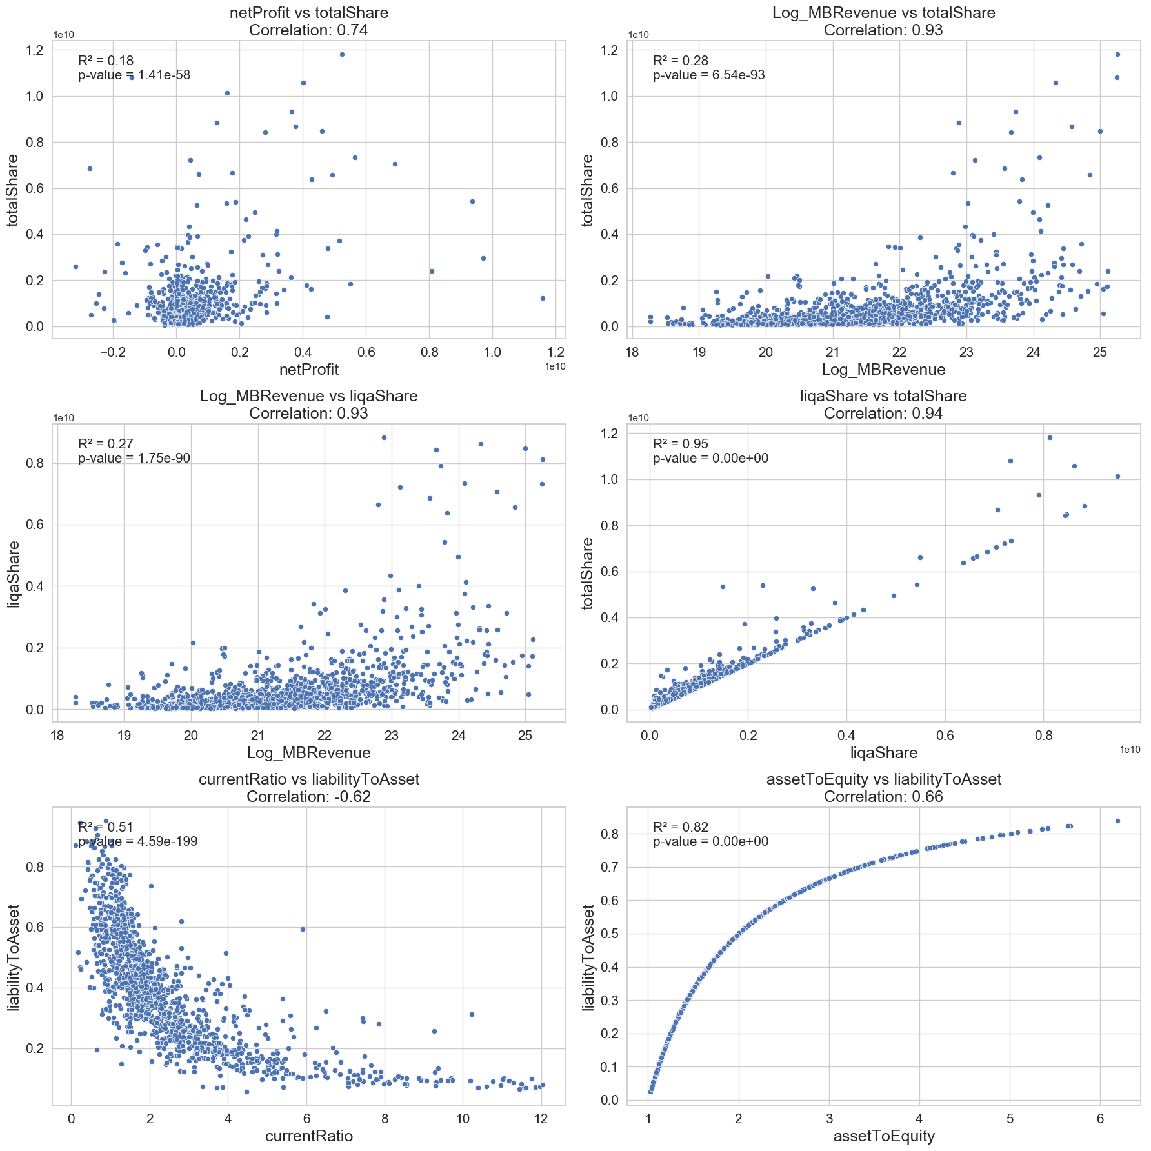
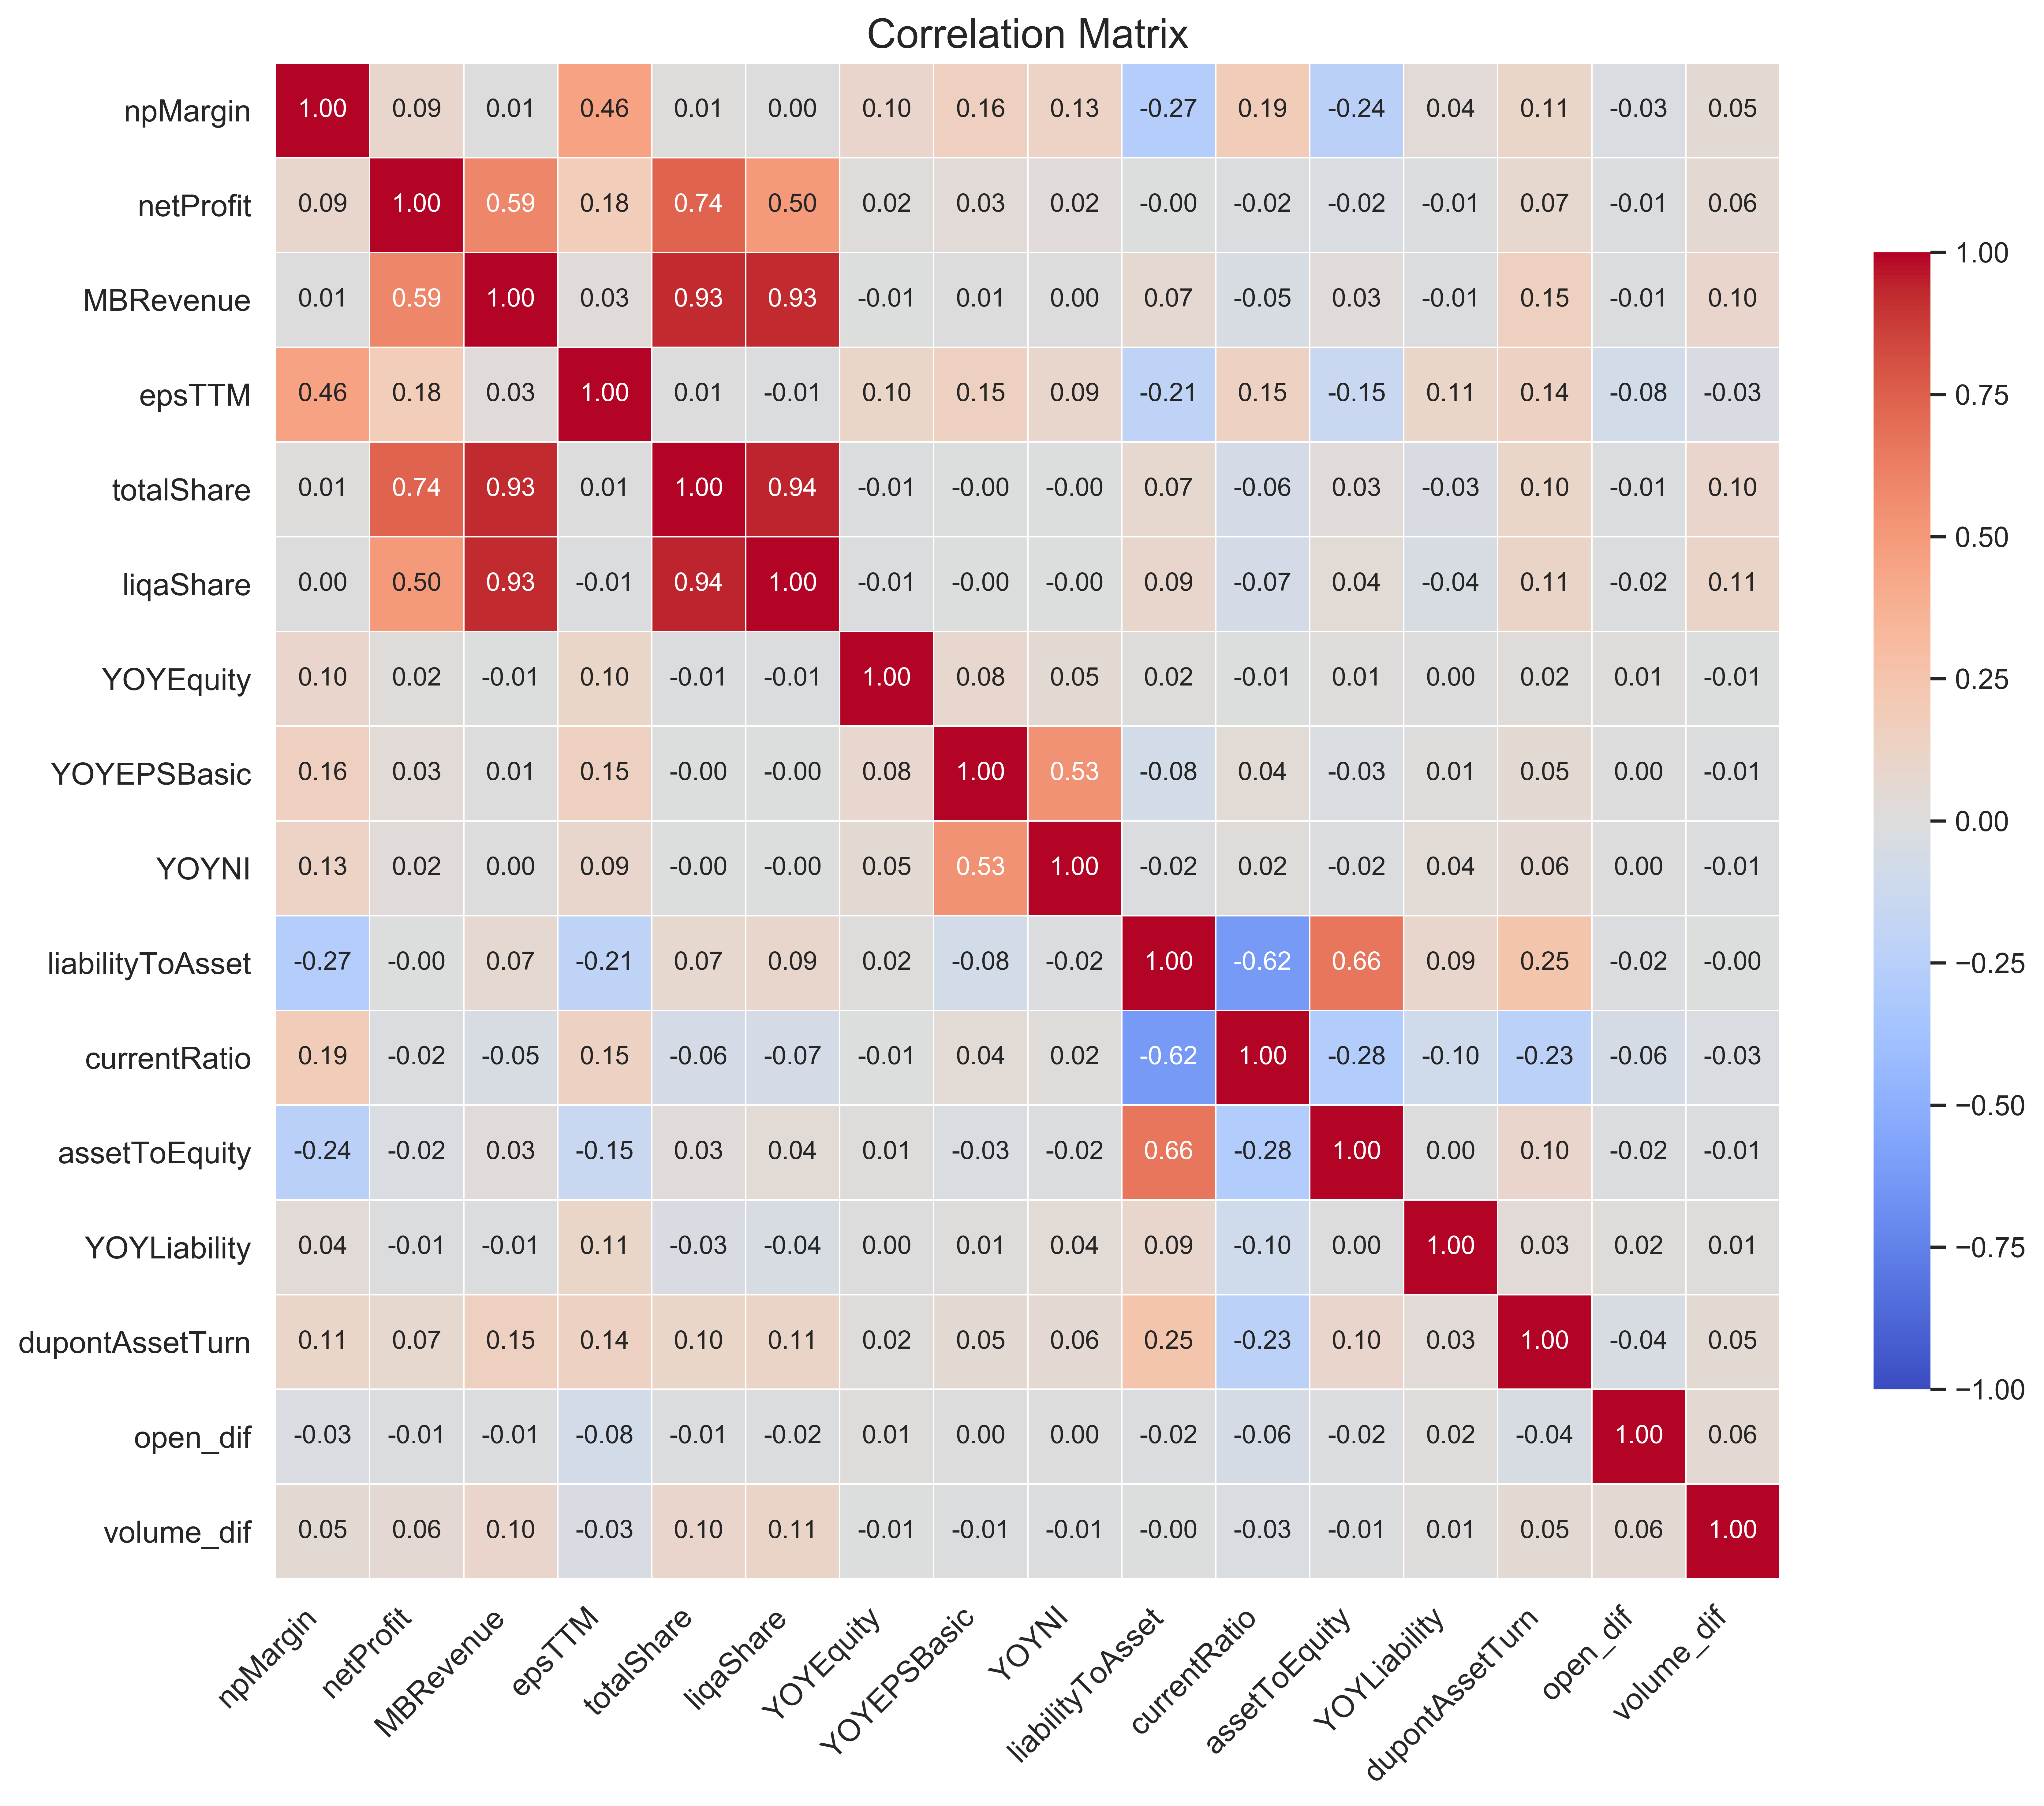
Data Analysis
EDA

Slide 10
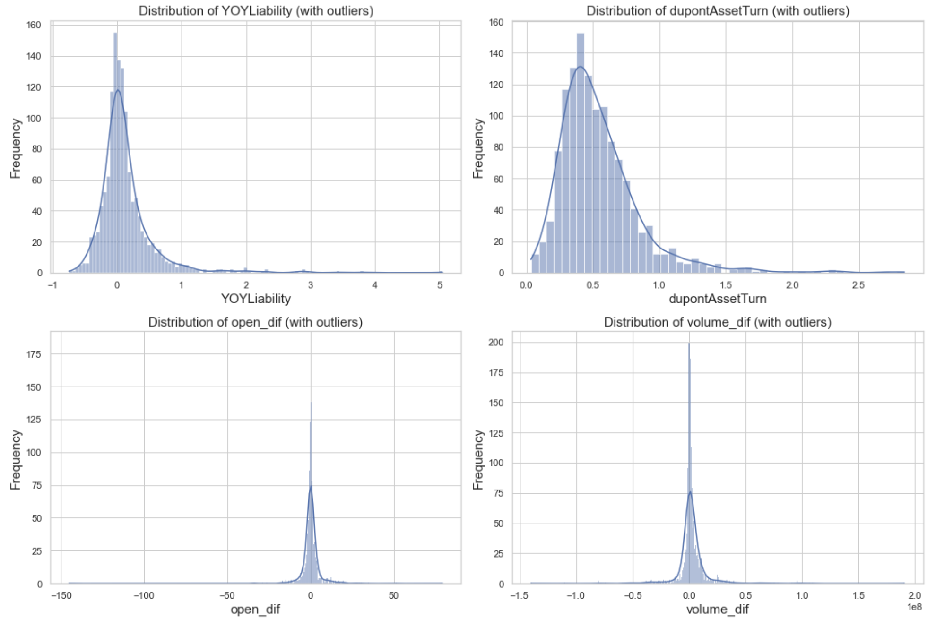
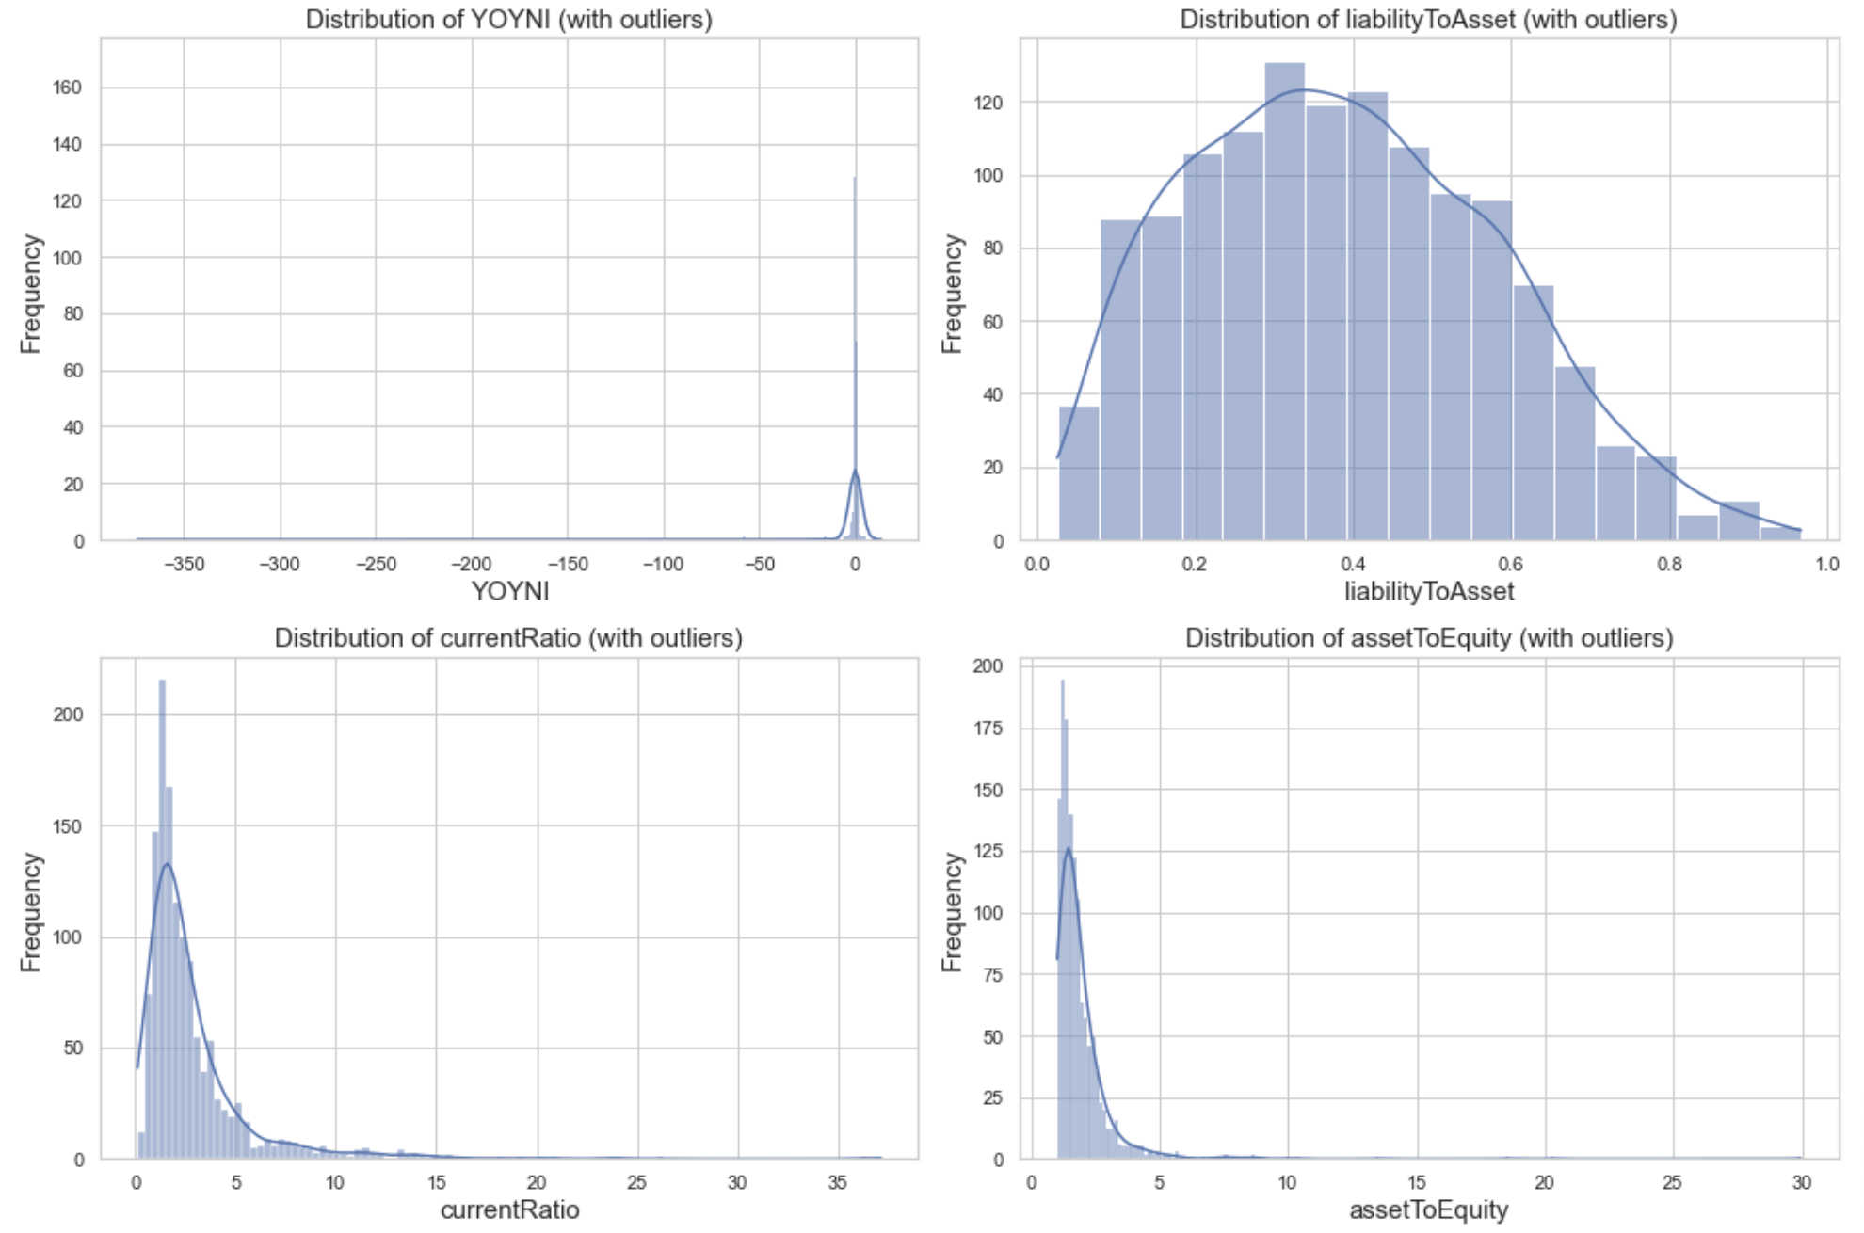
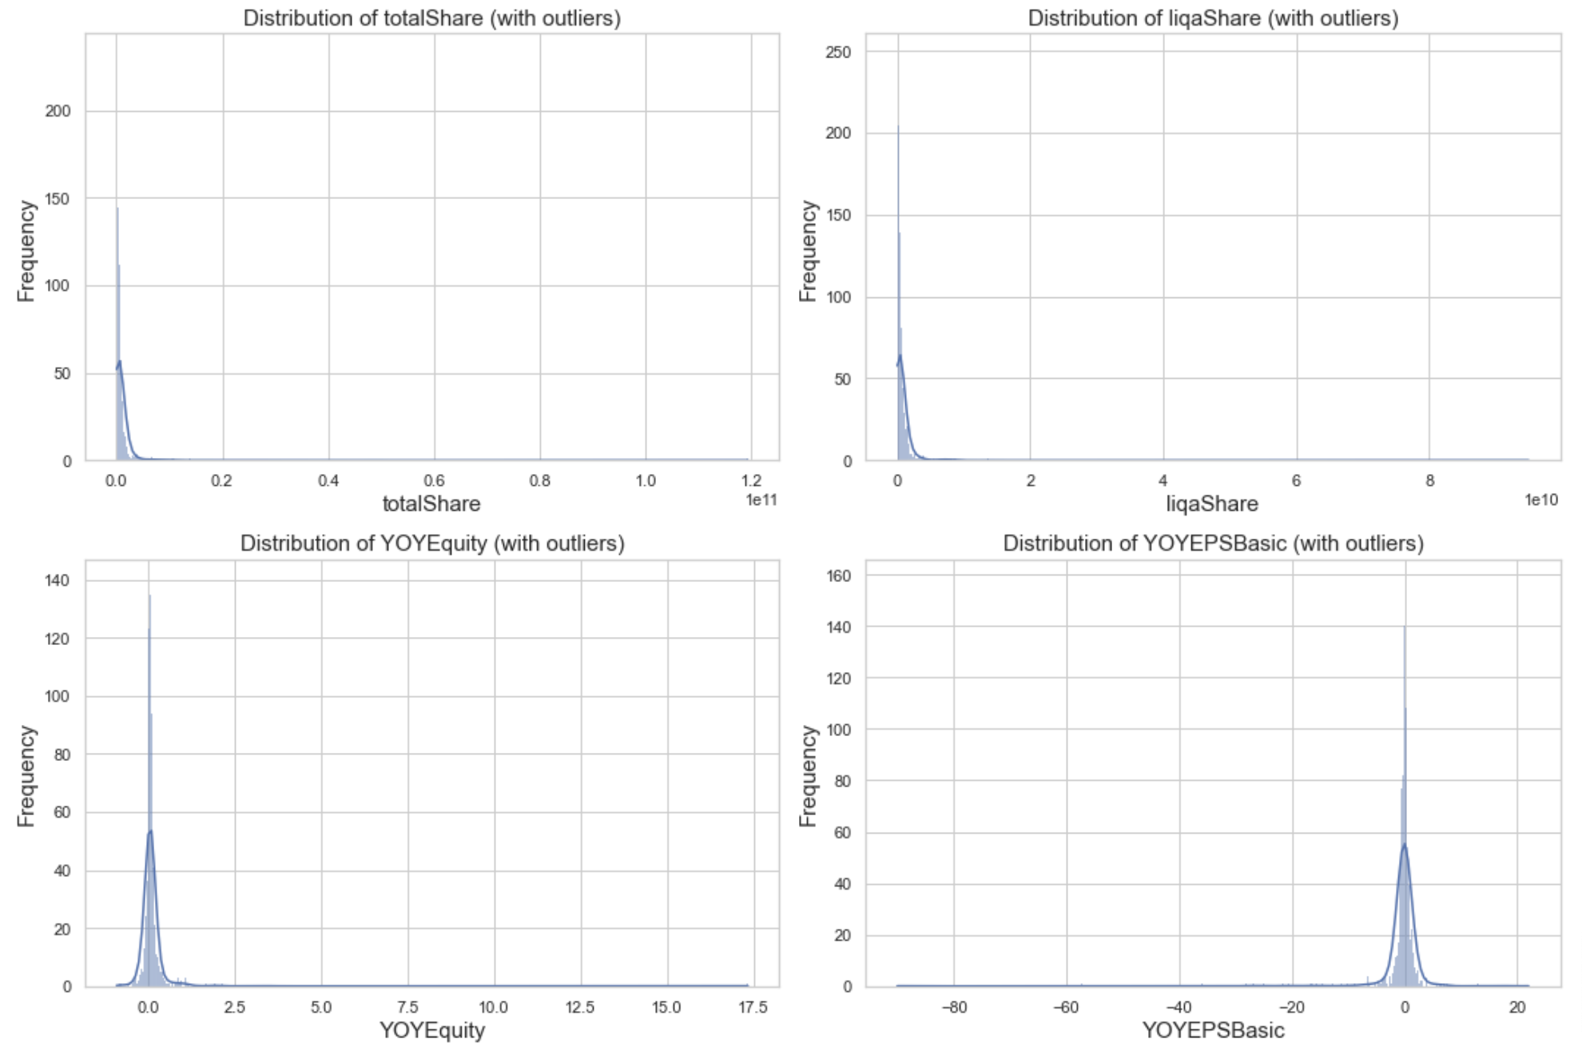
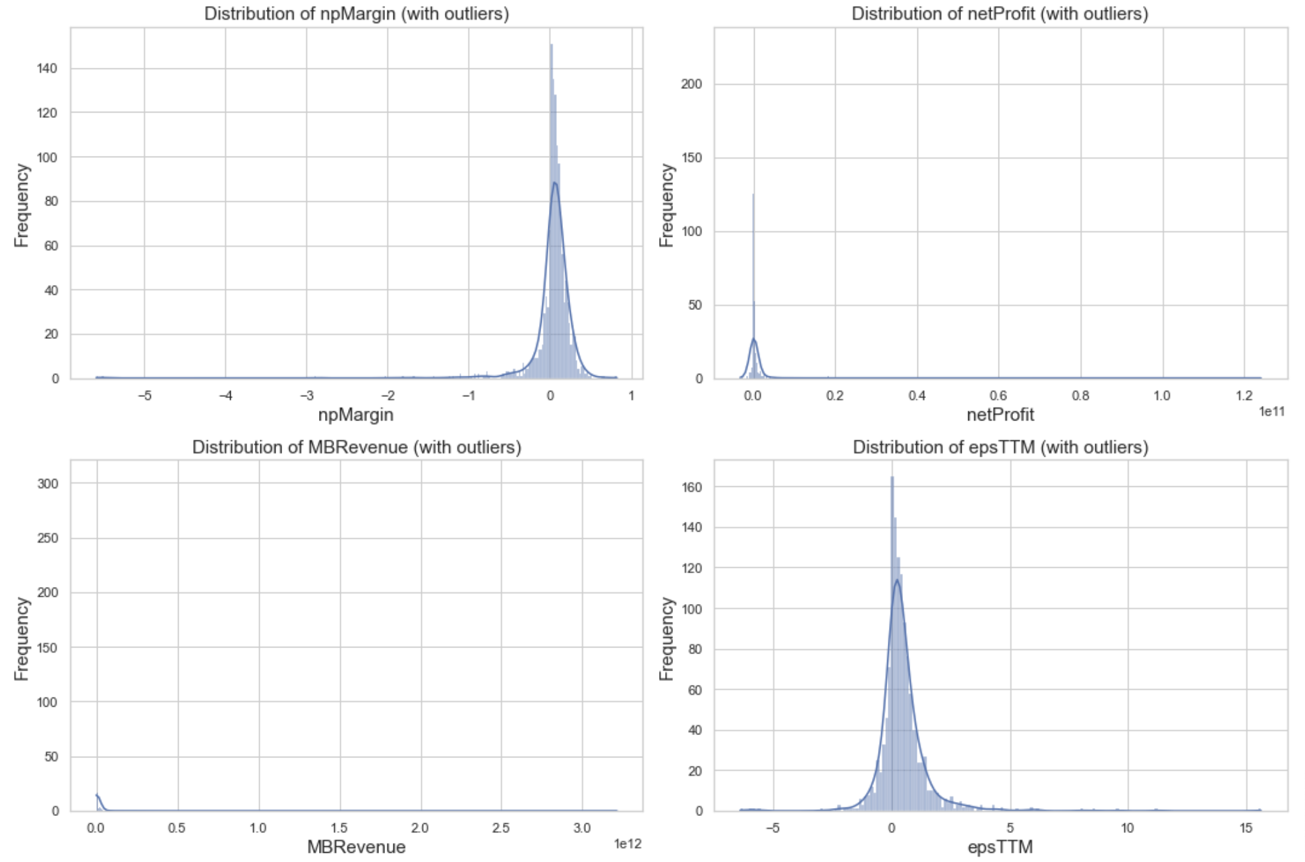
Data Analysis
With Outliers
Without Outliers
Our analysis of industry stock prices and earnings will eliminate outliers firstly. Then analyze the outlier separately, which is more likely to unearth unicorn companies.

Slide 11
3.1
Company clustering

Slide 12
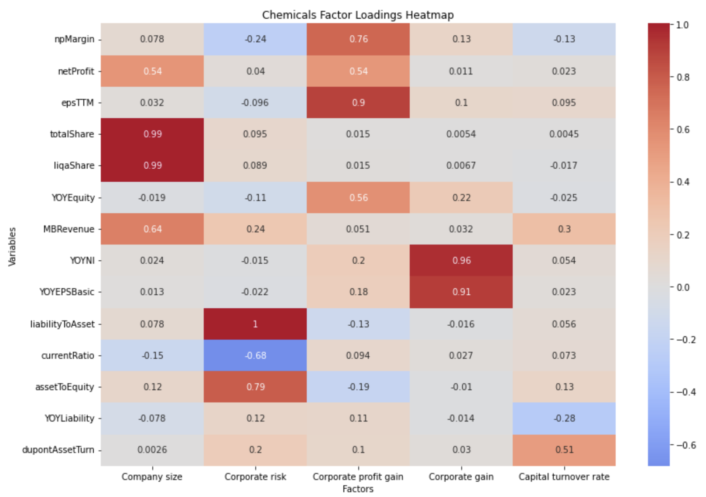
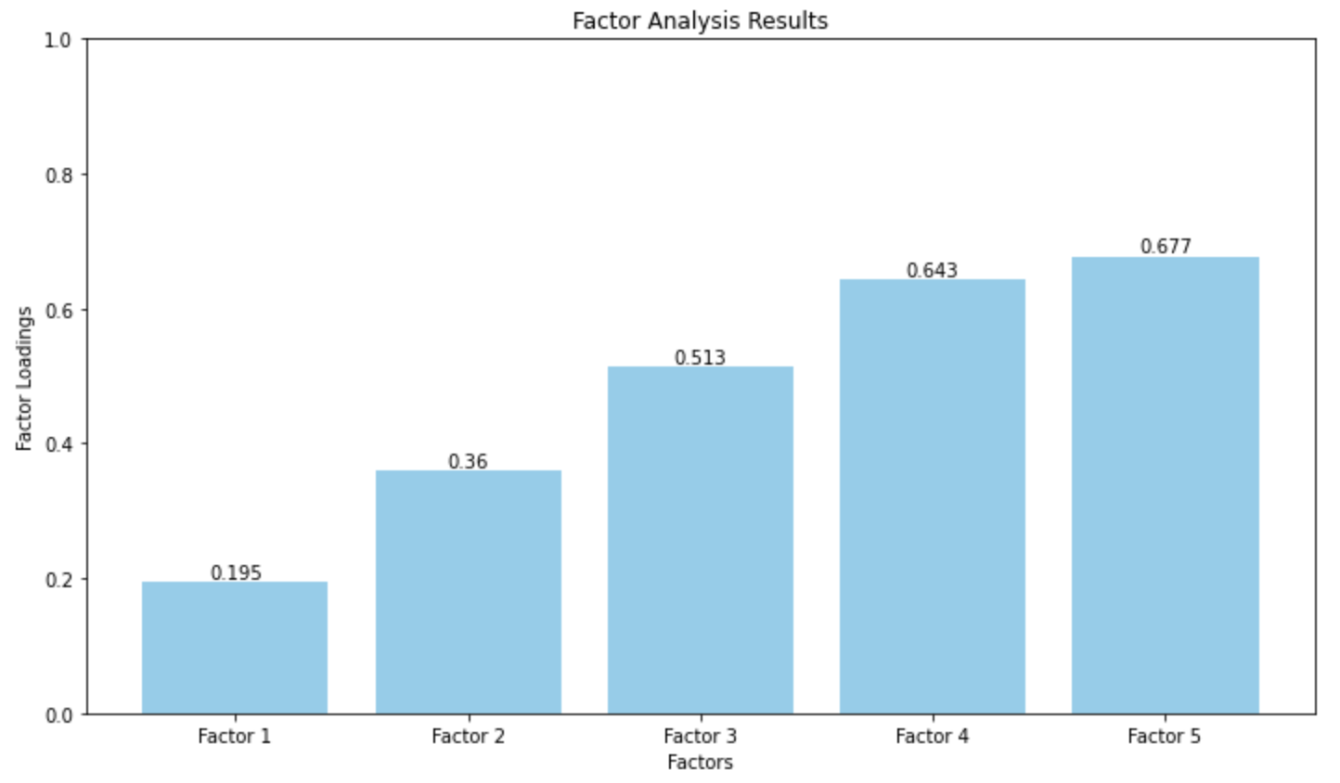
Data Analysis - Chemicals
Factor Analysis
Considering the interpretability and high factor cumulative variance contribution rate, we choose the number of extracted factors to be 5.

Slide 13
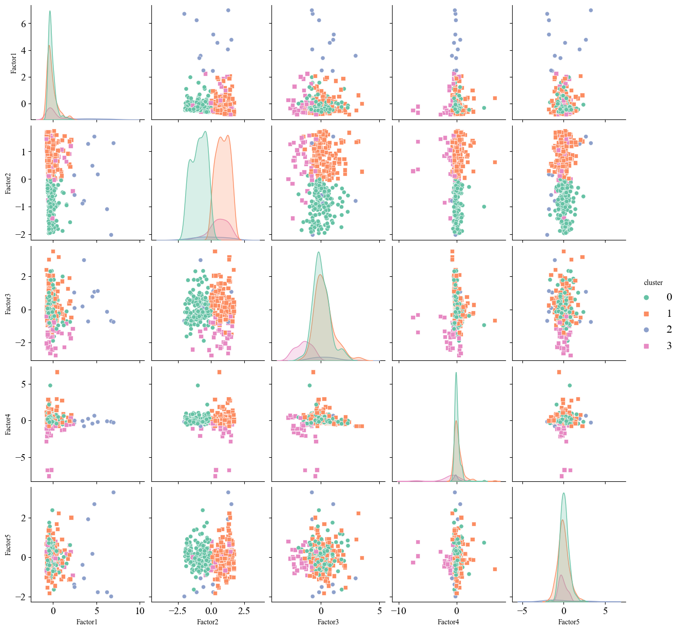
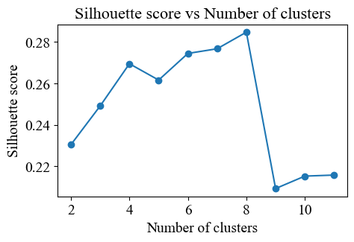
Data Analysis - Chemicals
K means Clustering
·The number of clusters we selected is 4, considering silhousette score.
Scatter matrix diagram of factor analysis and clustering results

Slide 14
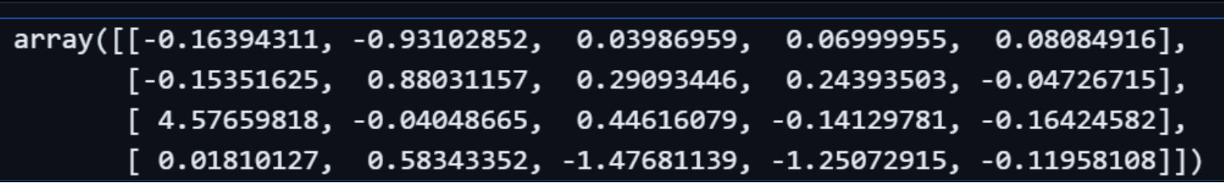
Data Analysis - Chemicals
K means Clustering
Category 1 (Cluster center point: [-0.16394311, -0.93102852,0.03986959, 0.06999955, 0.08084916])
Company size (-0.164) : The company size is small.
Corporate risk (-0.931) : Very low risk.
Corporate profit gain (0.040) : Profit gain was slightly positive.
Company stock gain (0.070) : There was a slight positive increase in stock gain.
Capital turnover rate (0.081) : High capital turnover rate
Category 2 ……

Slide 15
Data Analysis - Chemicals
K means Clustering - Summary
Category 1
usually smaller, very low-risk companies
do not have much profit and stock gains, but have good capital turnover
suitable for risk averse investors, and may be some soundly run small businesses.
Category 2
typically smaller, relatively high-risk companies
good profit performance, although the capital turnover rate is slightly lower,
high-risk high-return small businesses.

Slide 16
Data Analysis - Chemicals
K means Clustering - Summary
Category 3
typically very large businesses,
negative stock gains and low capital turnover despite near-medium risk and significant profit gains
may be some large businesses that are large but face challenges in the stock market.
Category 4
businessesclose to average size, facing moderate to high risks
significant reductions in profits and stock gains, low capital turnover rates,
may be businesses in poor operating conditions.

Slide 17
3.2
Industry stock selection recommendations

Slide 18
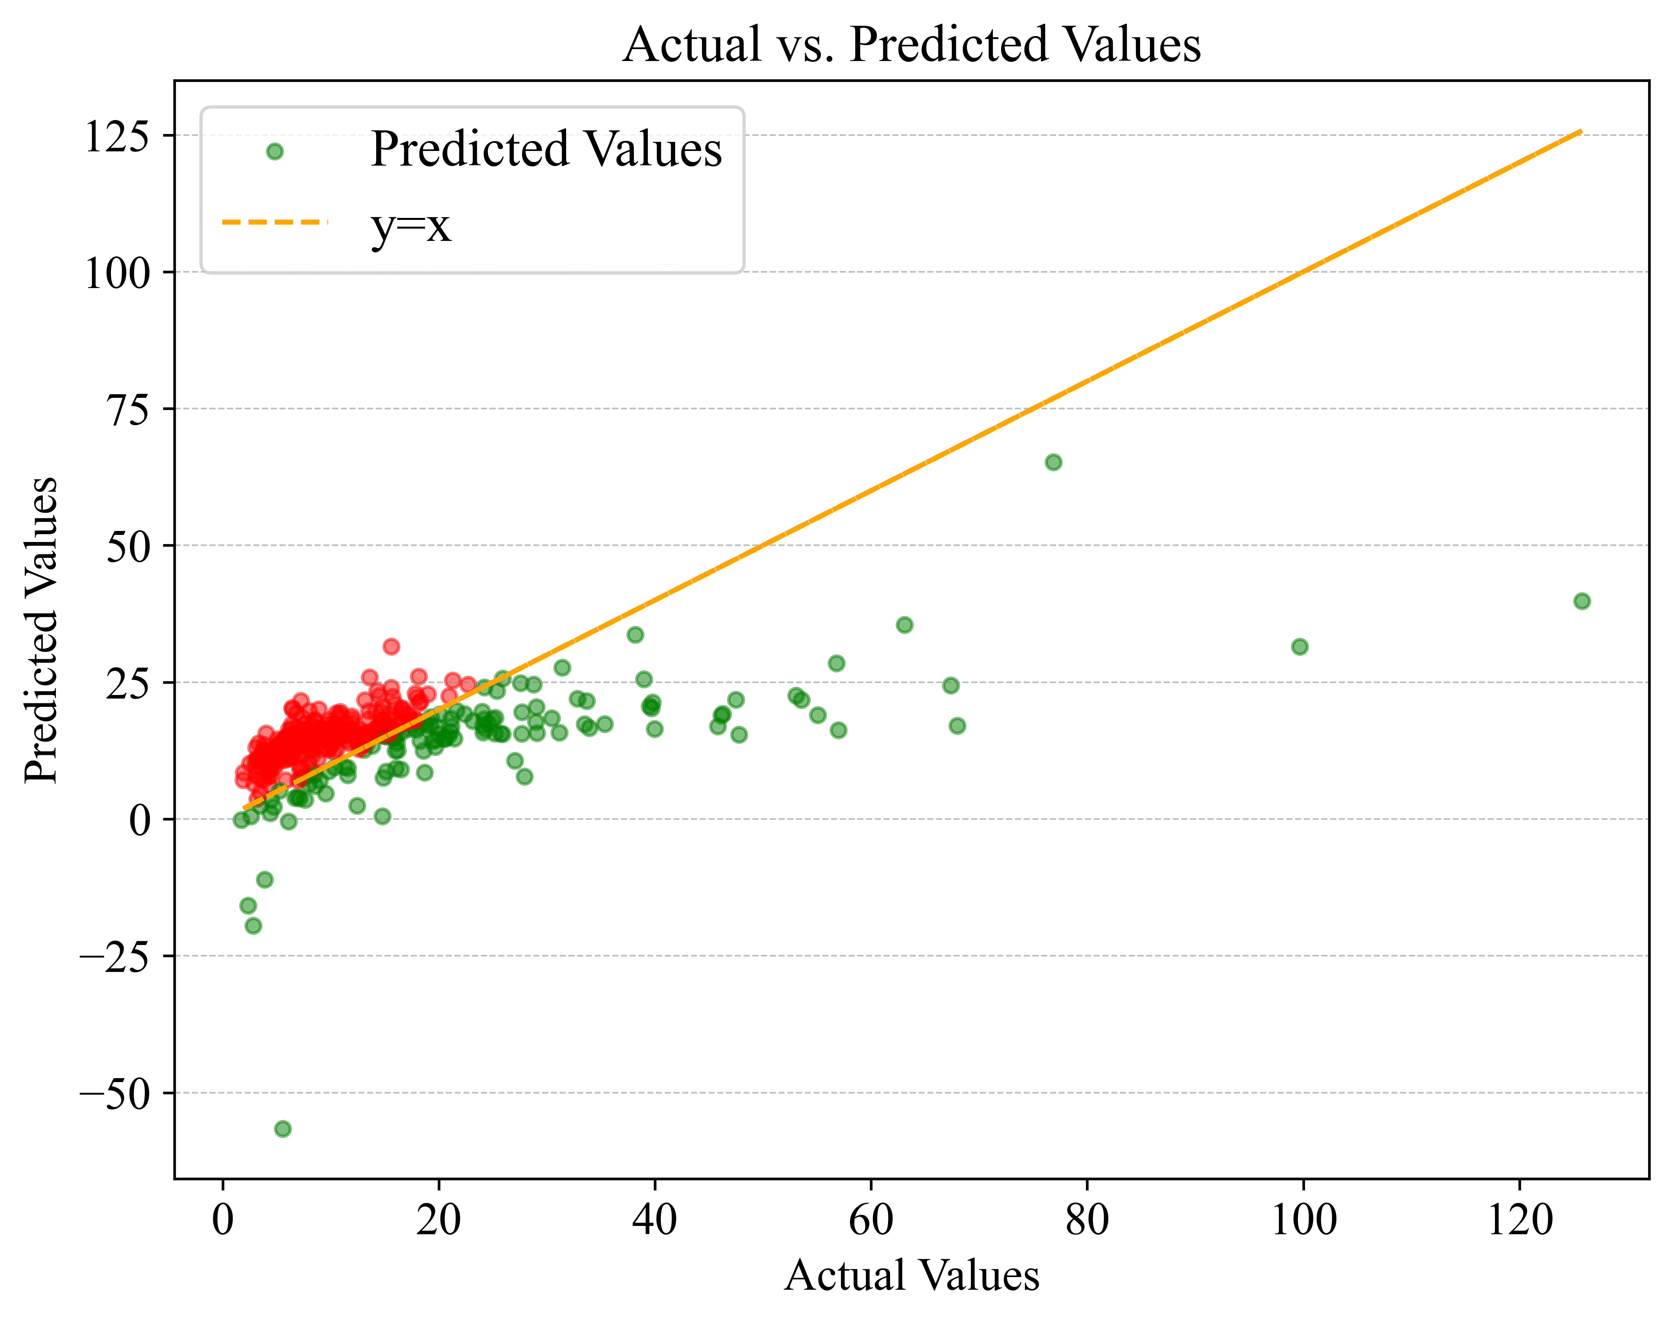
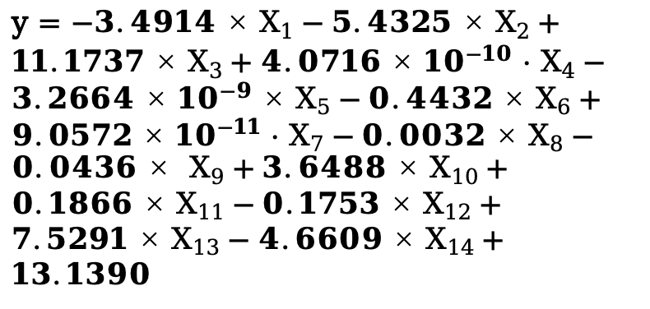
Data Analysis - Chemicals
Multiple Linear Regression
y = $−3.4914×X_{1}−5.4325×X_{2}+11.1737×X_{3}+4.0716×{10}^{−10} ·{ X}_{4}−3.2664×{10}^{−9}×X_{5}−0.4432×X_{6}+9.0572×{10}^{−11} {· X}_{7}−0.0032×X_{8}−0.0436× X_{9}+3.6488×X_{10}+0.1866×X_{11}−0.1753×X_{12}+7.5291×X_{13}−4.6609×X_{14}+13.1390$
Best alpha: 300.0
Test MSE with RidgeCV: 780.3329

Slide 19
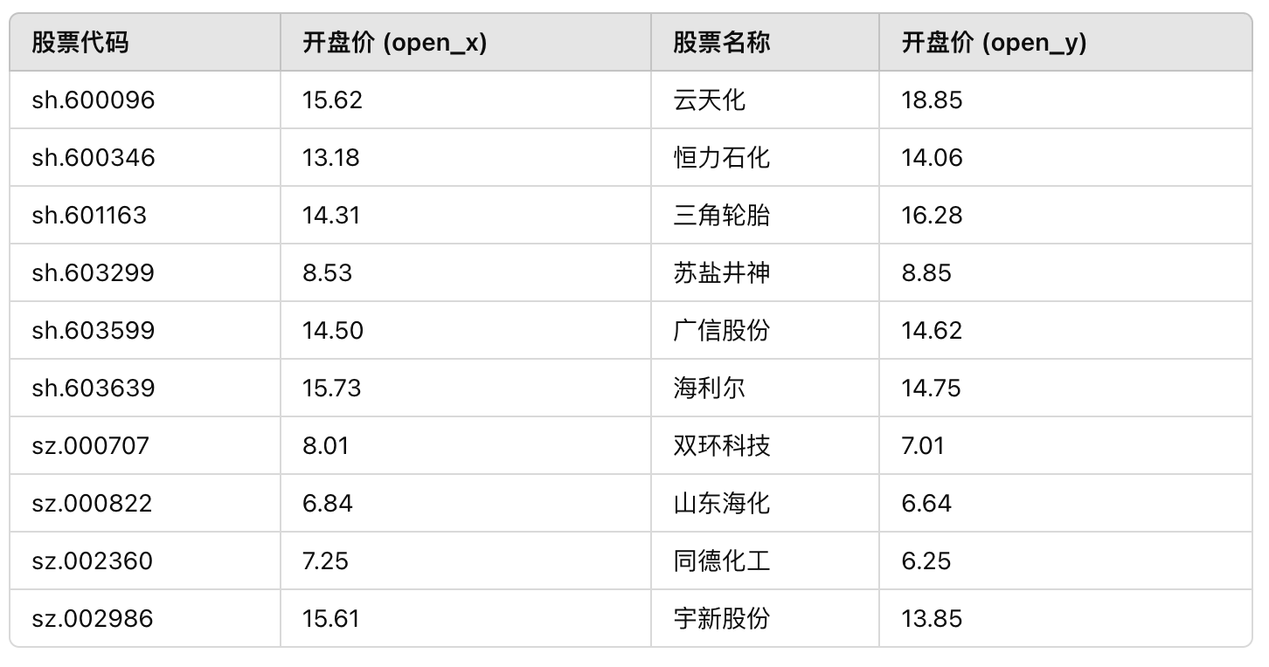
Data Analysis - Chemicals
Potential Stock Prediction
Defining potential stocks:
The predicted price of the stock is higher than the actual price
The return of the stock is positive overall (i.e. higher than the red line, can only be screened, not ranked)
Rank: Stock Yield * residual (residual between yield and red line)
Average gains for all stocks in the chemical：
-1.849
Average gains for adviced stocks in the chemical：
+0.158

Slide 20
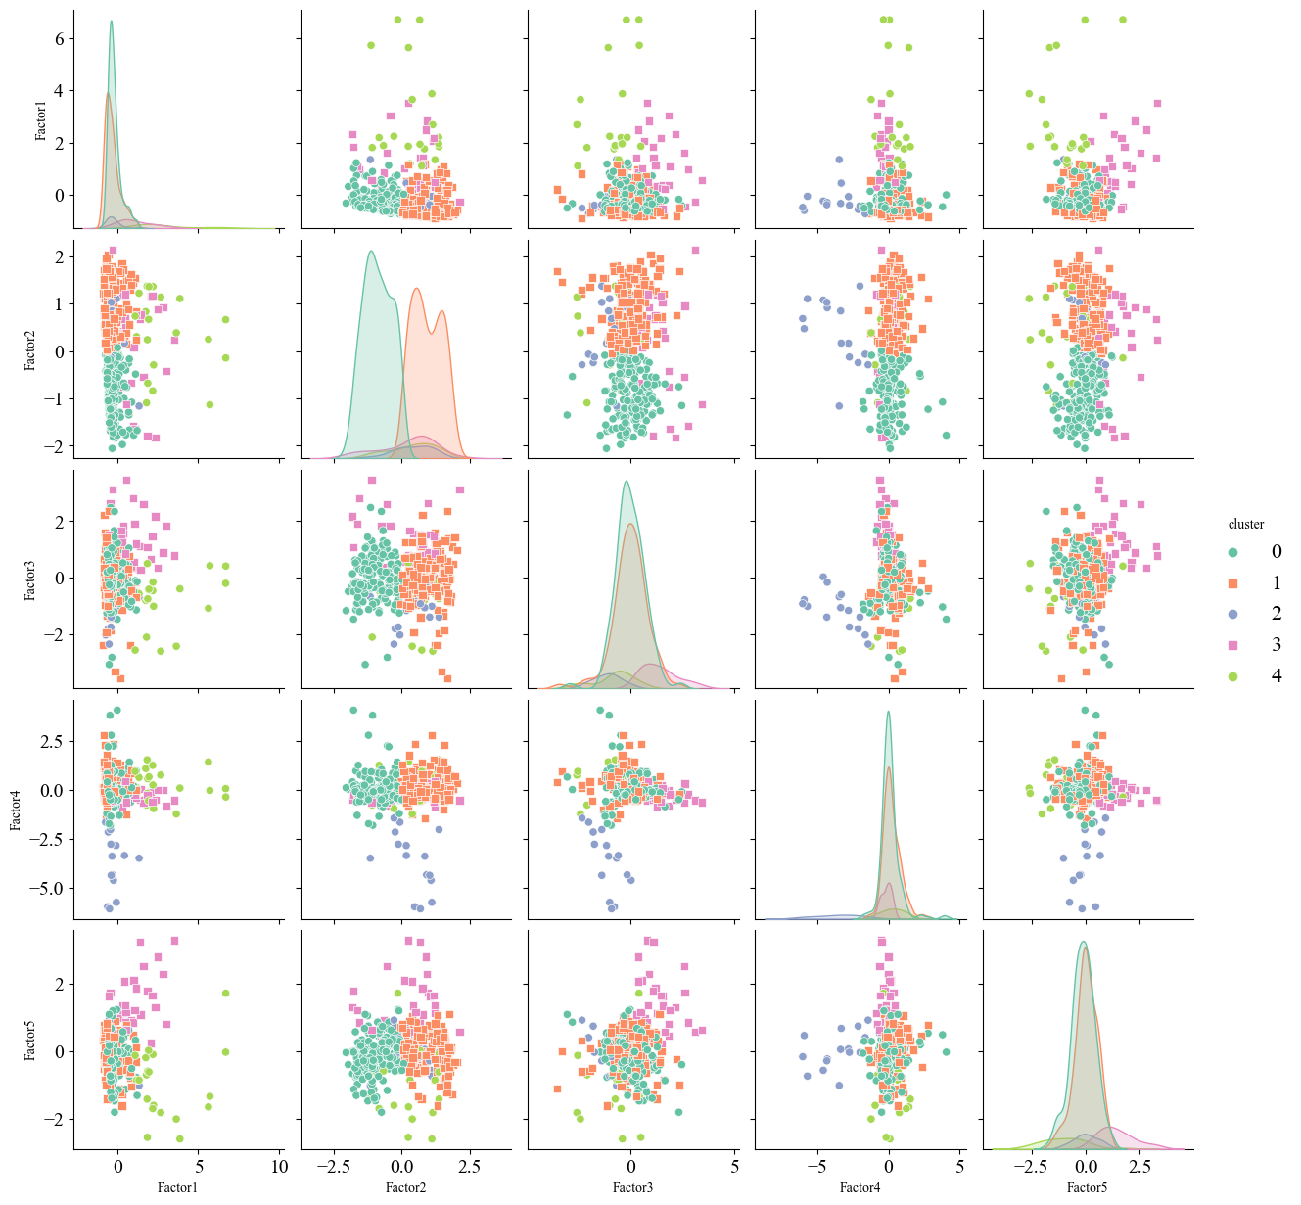
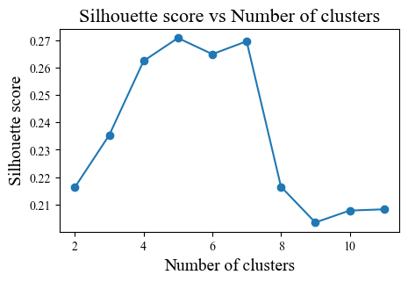
Data Analysis - Machinery
Potential Stock Prediction
· n_factors = 5

Slide 21
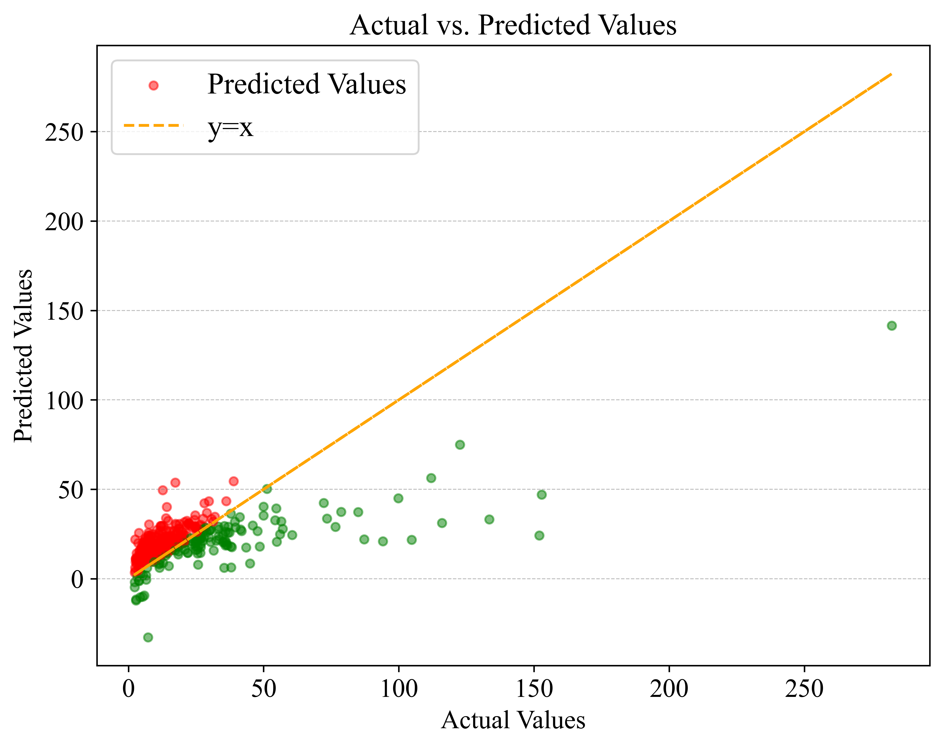
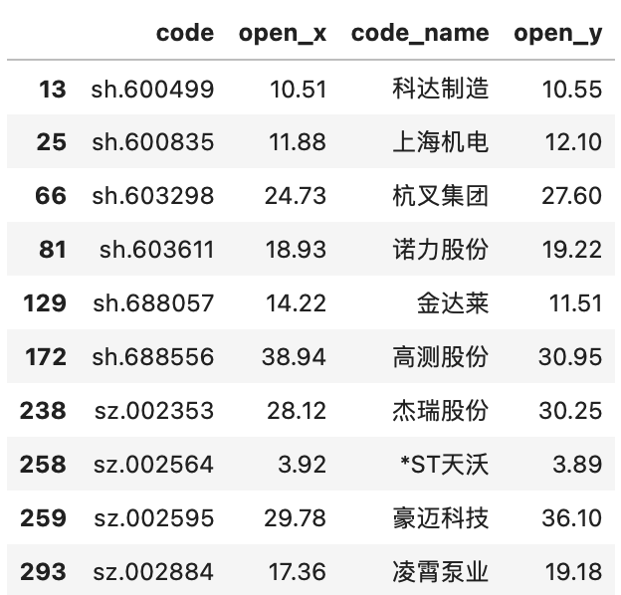
Data Analysis - Machinery
Potential Stock Prediction
· Average gains for all stocks
in the mechinery：-2.1526
· Average gains for adviced stocks
in the mechinery：+0.296

Slide 22
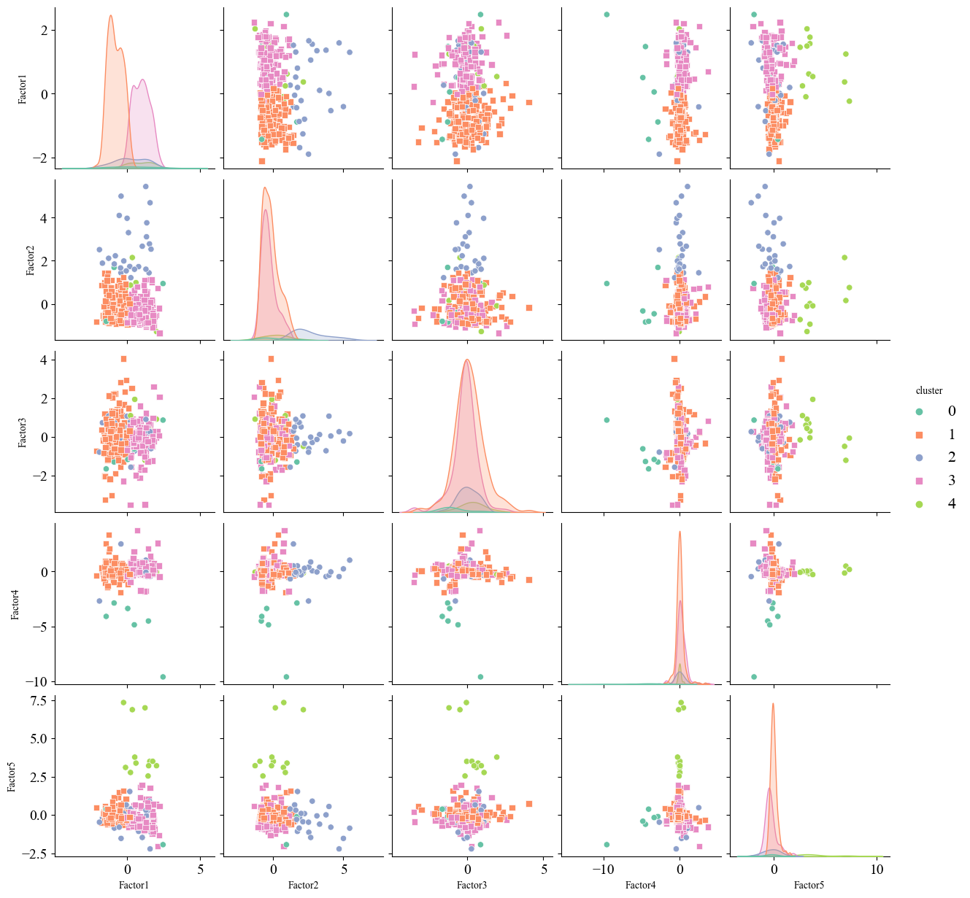
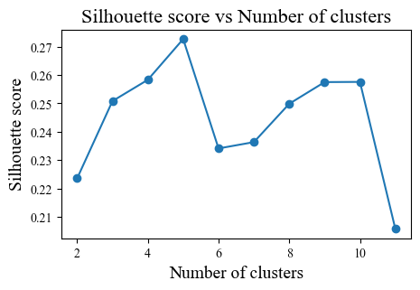
Data Analysis - Pharmaceuticals
Potential Stock Prediction
· n_factors = 5

Slide 23
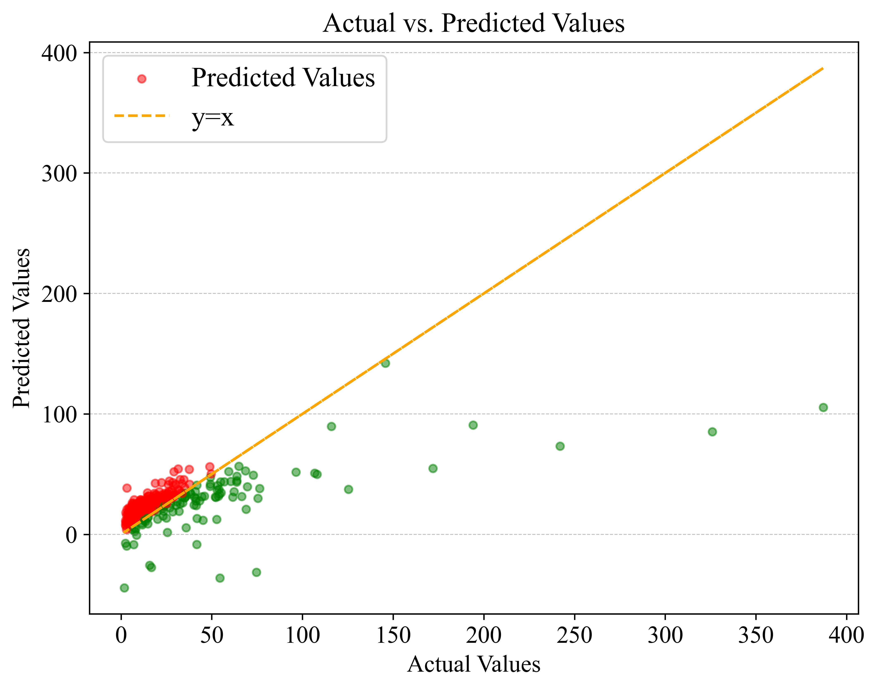
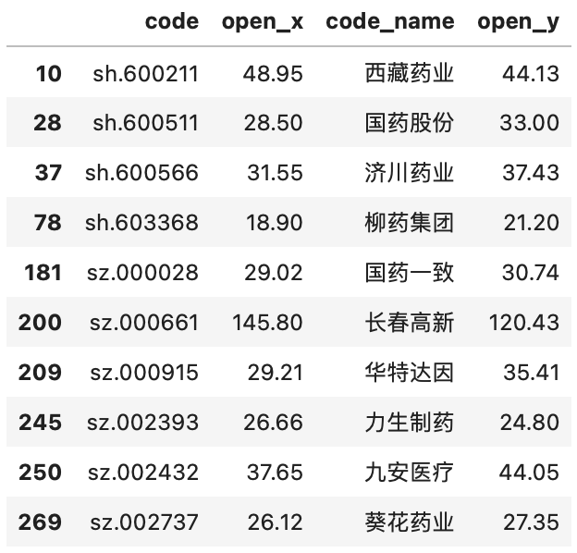
Data Analysis - Pharmaceuticals
Potential Stock Prediction
· Average gains for all stocks
in the Pharmaceuticals：-3.3668
· Average gains for adviced stocks
in the Pharmaceuticals：-0.382

Slide 24
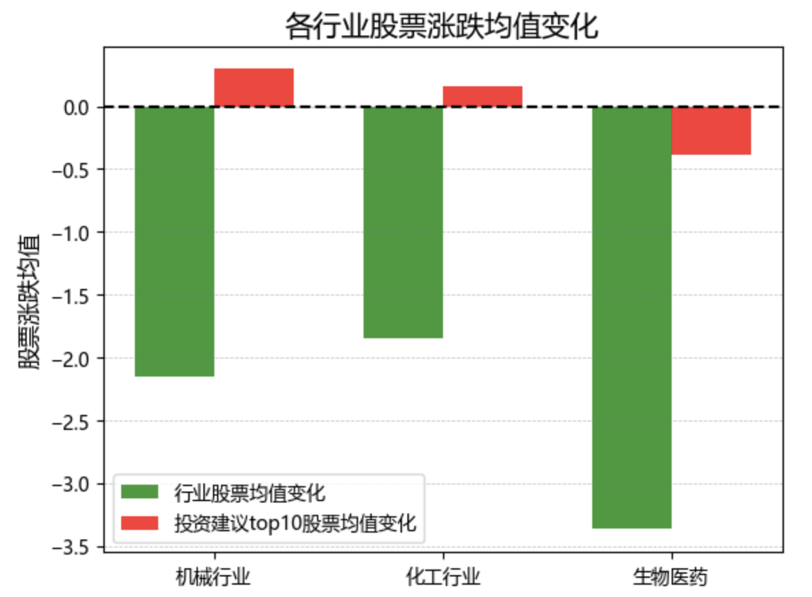
Potential Stock Prediction

Slide 25
3.3
Outlier Exploration

Slide 26
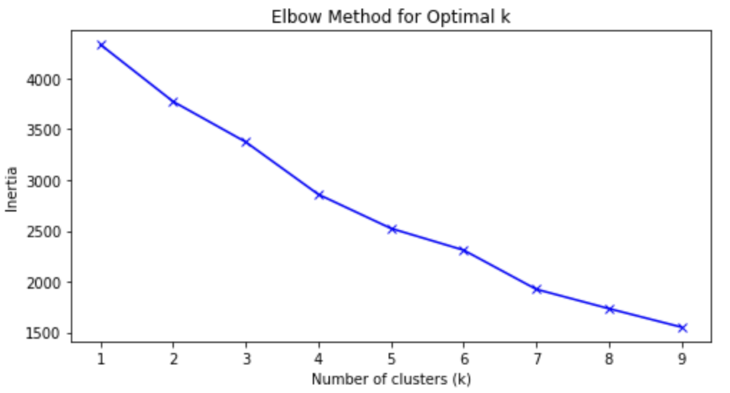
Outlier Exploration - Chemicals
Select the appropriate number of clusters
Elbow rule
The decline rate of inertia value at 4 is significantly slower

Slide 27
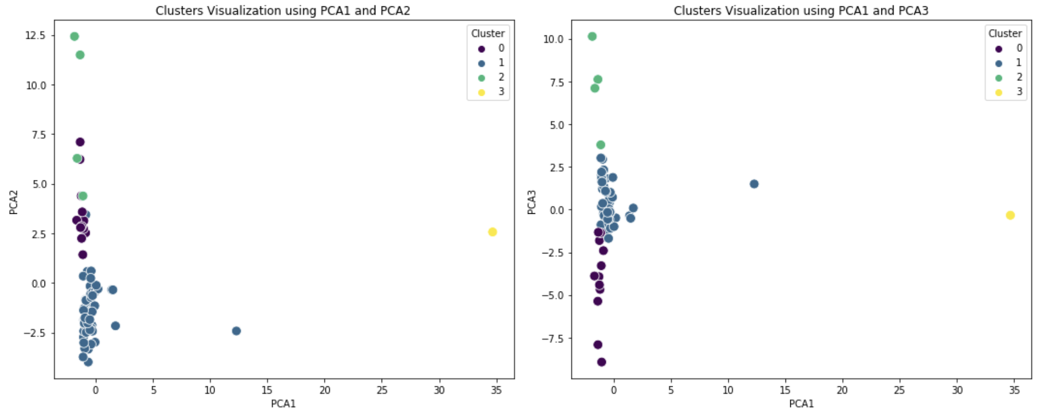
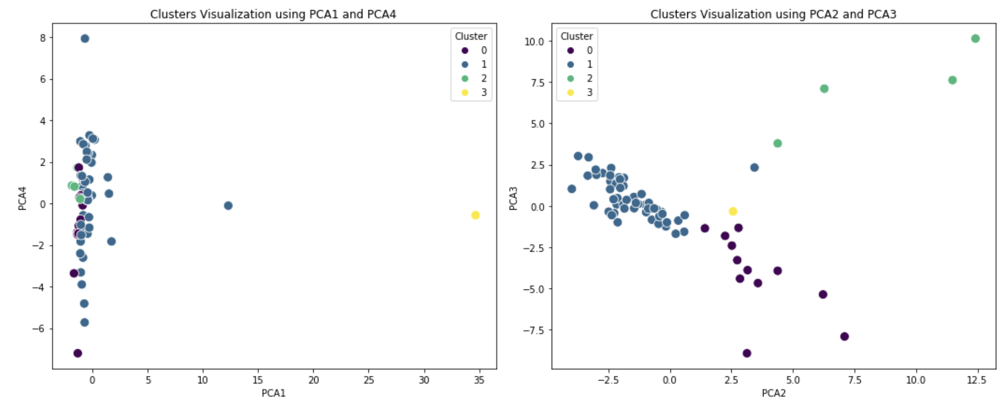
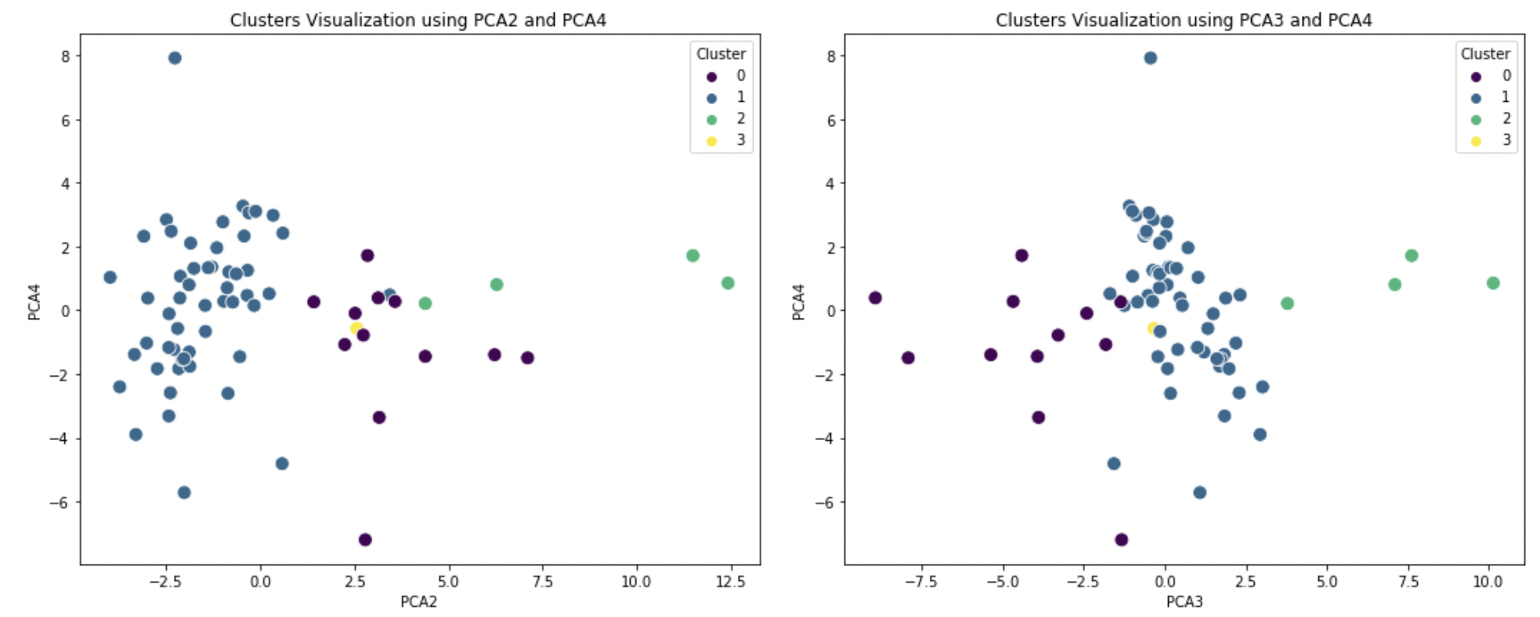
Outlier Exploration - Chemicals
PCA

Slide 28
Outlier Exploration - Chemicals
· Get the components of the four components of PCA.
· Filter out the parts whose absolute weight value is greater than 0.3 in each principal component.
PCA1 Components
PCA2 Components
Selected Columns | Weights
netprofit | 0.4050
totalShare | 0.5318
liqaShare | 0.4995
MBRevenue | 0.5230
Selected Columns | Weights
npMargin | -0.4003
YOYNI | -0.4935
YOYEPSBasic | -0.4449
assetToEquity | 0.3020
PCA3 Components
PCA4 Components
Selected Columns | Weights
npMargin | 0.3342
YOYNI | -0.4831
YOYEPSBasic | -0.4865
assetToEquity | -0.4998
Selected Columns | Weights
currentRatio | -0.3103
YOYLiability | 0.3444
lopen_dif | 0.7356
volume_dif | 0.3443

Slide 29
Outlier Exploration - Chemicals
Interpretation
PCA1: Net profit(+) , total equity(+) , circulating equity(+) , main operating income(+)
representing the overall volume
PCA2: net sales profit margin (-), net profit year-on-year growth rate (-), basic earnings per share year-on-year growth rate (-), equity multiplier (+)
representing poor management, heavy financial burden, reduced income, and wide financing
PCA3: net sales profit margin (+), net profit year-on-year growth rate (-), basic earnings per share year-on-year growth rate (-), equity multiplier (-)
representing profitable, but with reduced income this quarter and narrow financing
PCA4: Current ratio (-), total debt year-on-year growth rate (+), stock price increase (+), trading volume increase (+)
representing companies operating with high debt will experience short-term growth

Slide 30
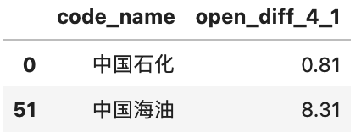
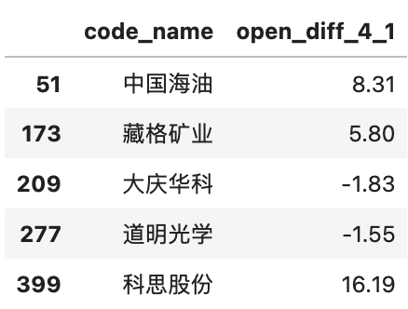
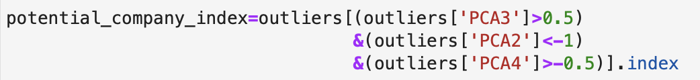
Outlier Exploration - Chemicals
Focus on big companies (i.e. large PCA1)
Screen for other companies that may perform well

Slide 31
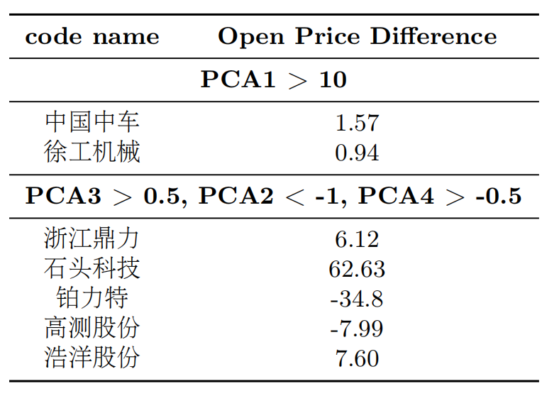
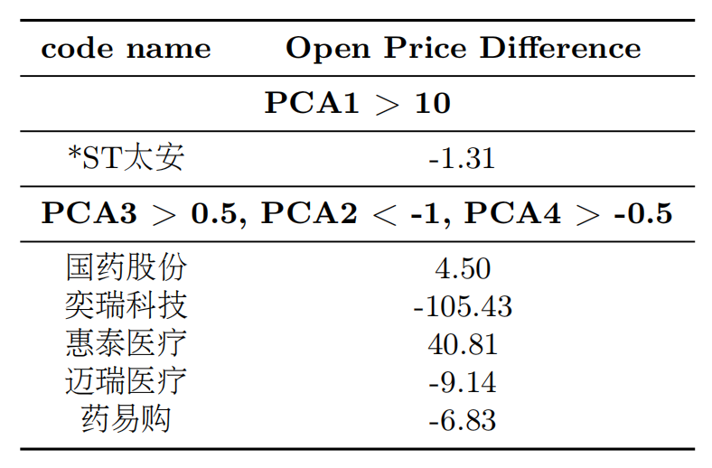
Outlier Exploration
Machinery
Pharmaceuticals

Slide 32
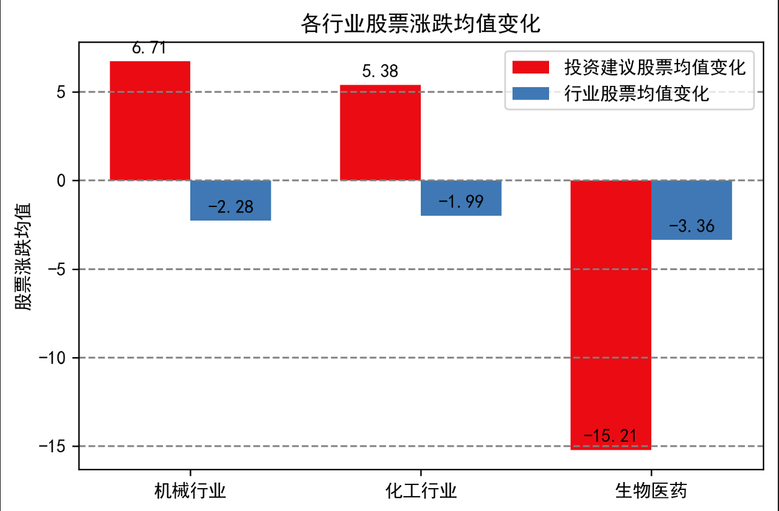
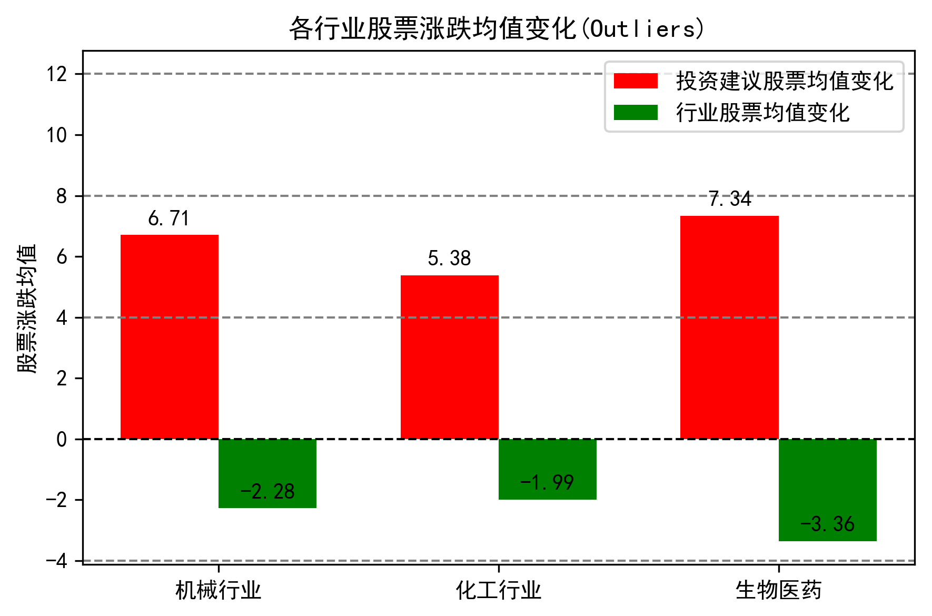
Outlier Exploration

Slide 33
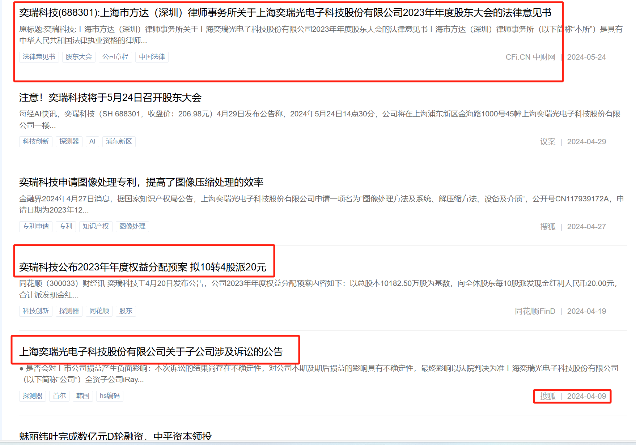
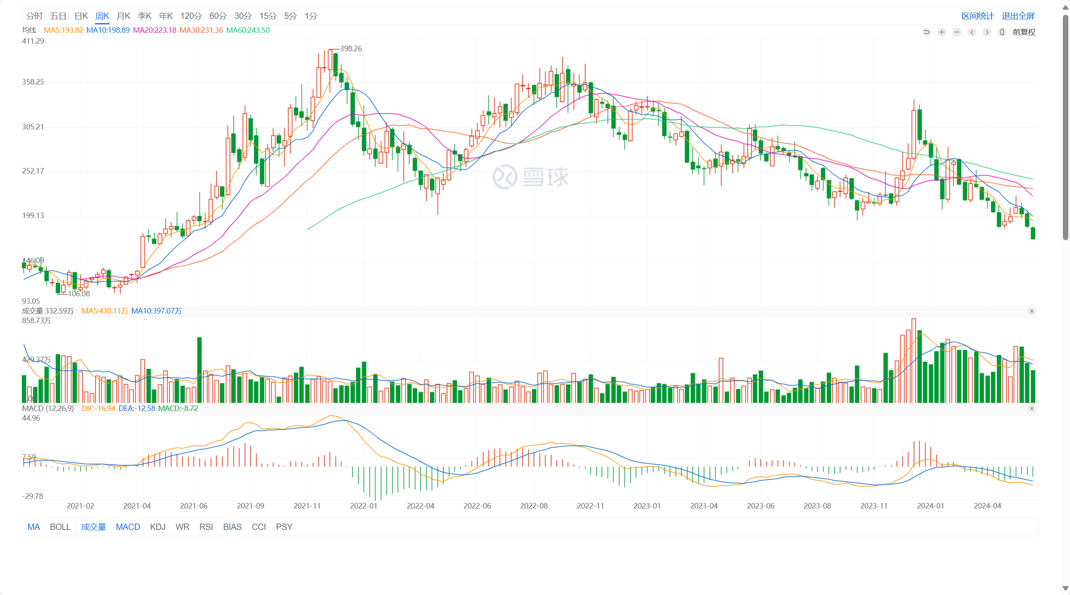
Outlier Exploration
奕瑞科技
整体趋势
训练区
测试点

Slide 34
Conclusion
The practical application of statistical methods in financial analysis, offering in_x0002_sights into the financial health and potential perfor_x0002_mance of stocks in different industries.
Weakness：
No additional risk information related to the company is incorporated
The time period is only considered for one quarter rather than a long time series.

Slide 35
Thanks For Watching！

